Slide 1
Fairfields Primary School Early Years Foundation Stage – Transition and Induction

Slide 2
Transitions
There are two types of transitions: horizontal and vertical. Horizontal transitions happen consecutively during the day between home and other carers and settings. Vertical transitions are the milestones on the way to school and beyond.
‘Separation distress’ is something all children will feel, to varying degrees and is within children up until around the age of 7, sometimes beyond. Therefore it is fundamental to ensure a smooth transition to school, as much as is possible.
The general ‘journey’ life presents children with, expects them to go through many transitions during their early years, in a period in which they are designed to resist it! Starting school is a big change for children and we will support them as much as we can, to settle quickly and embrace their new change.

Slide 3
To support the transition experience:
We will enable every child:
To feel a sense of belonging
To feel held in mind
To feel like a ‘fish in water’
All of which contribute to feelings of safety and unconditional acceptance which will enable them to feel:
Ready, willing and able to make the most of their new situation and to ‘hit the ground running’.

Slide 4
Our transition programme:
Virtual home visits: This enables your child (and you) to meet their Class Teacher and adults within their environment before starting school. Talking to your child about the adults in school will help them to understand that they will be seeing us everyday, come September and will make us more familiar to them.
Settling in ‘open sessions: These will provide your child with the opportunity to meet their new class friends and meet the adults, this time in person, prior to school starting.

Slide 5
Our transition programme (continued):
Phased induction to school: During the first week of school, your child will be welcomed in through a scaffolded approach, building up the length of sessions throughout the week. This approach has been very successful for our children in the past and supports a smooth transition into school and, more importantly, gives them lots of opportunities to meet their friends and teachers in their environment in a relaxed and calm way.

Slide 6
Our transition programme (continued):
Monday 7th and Tuesday 8th September | Morning only (8.30 – 11.30)
Wednesday 9th and Thursday 10th September | Morning and lunch (8.30 – 12.30)
Friday 11th September | All day (8.30 – 3.30)
From Monday 14th September | Usual school hours (8.30-3.30)

Slide 7
Ongoing support:
Home – School communication: While we recommend that dropping children off to school in the morning is a swift and smooth transition, communication between adults is important from the beginning. There are many factors that may impact your child on a day to day basis, for example not eating breakfast, an interrupted night’s sleep, a disagreement with a family member etc. By making us aware of these, will enable us to support your child better throughout the day. Likewise, if your child has had a difficult day, we will make you aware of this – and will also communicate the good days too!
EEXAT: We use an online tool (more information will follow once your child has started with us) to send observations home on a weekly basis. This provides you with an insight into the experiences your child has at school and provides you with a talking point.

Slide 8
A typical day:
The Early Years Foundation Stage (EYFS) at Fairfields Primary School provides children with the opportunities to experience the best possible start to their education and future years at school. Through grasping opportunities in child-initiated learning, partnered with direct teaching, children build a solid foundation to build on as they progress through their journey in KS1 education and beyond.
Short adult-led sessions daily: sentence building (based on a book); Read Write Inc phonics sessions – which will ultimately be grouped vertically across the school to support children learning at all paces and finally a maths session using concrete resources, pictorial representations and abstract ideas (a mastery approach).
Our learning environment and invitations to play are created around topics and interests of the children, where we encourage exploration and play, then ‘hop on’ to learning opportunities to develop and deepen understanding. This is called child-initiated learning, but the children will come to understand it as independent learning. Furthermore, during these sessions, we encourage children to challenge themselves to deepen and extend learning taught during the ‘adult-led’ sessions.

Slide 9
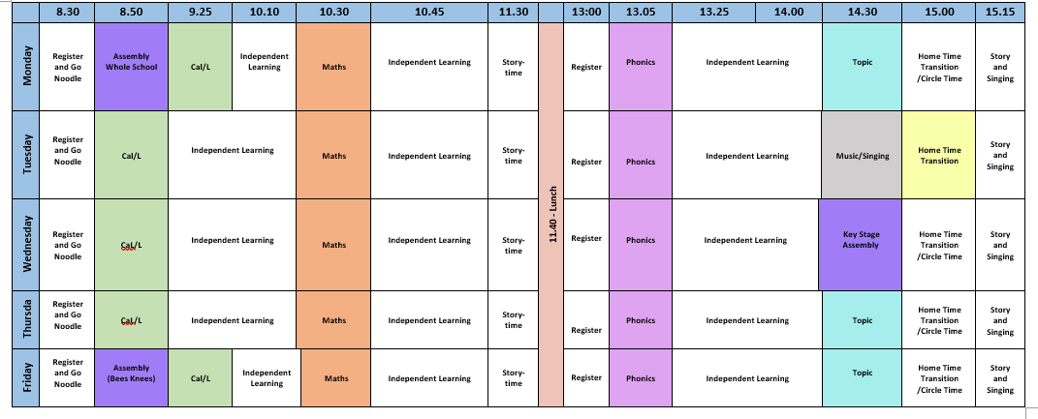
A typical timetable:

Slide 10
In the Autumn Term (parent information events):
Introduction to the Early Years Foundation Stage: 7 areas of learning Characteristics of Learning Purple Learner Challenges
Supporting your child’s learning at home
Reading and phonics workshops
Dates for these workshops will be communicated closer to the time.

Slide 11
Question and Answer Session
Thursday 9th July at 17:45pm
Meeting ID: 873 7579 7174 Password: Reception

