Slide 1
Welcome to the Year 3 and 4 Homework zoom
Please turn your camera on
and put yourself on mute.
Please save any questions until the end or ask your child’s class teacher directly. The chat function will not be monitored

Slide 2
A new normal
Thank you for all your support so far this year
Emphasis on maths and English
Daily lessons (reading, maths, English, SPaG/spelling)
PSHE – wellbeing
Collaborative effort to close the gaps

Slide 3
Reading
At home
Daily reading with an adult 5 times a week (signing reading records)
Important to read book band books but reading can include books at home
Focus on comprehension (asking a range of questions)
At school
All children will be read with at least once every 2 weeks (could be 1:1 or during book talk). Please can children bring in reading records every day.
Groups – HFW and phonics interventions

Slide 4
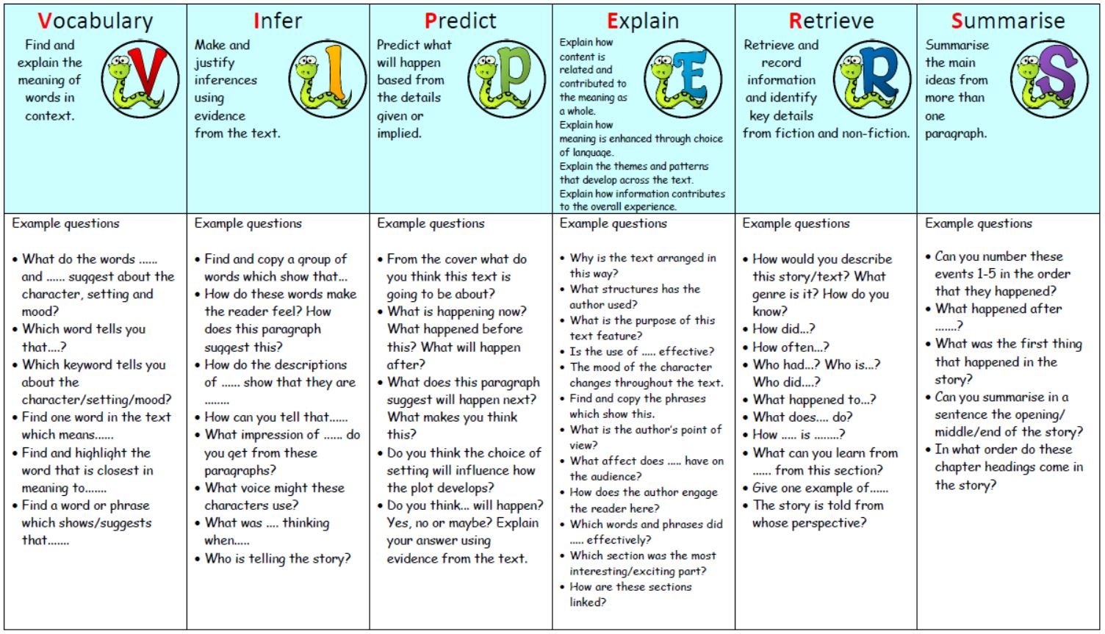

Slide 5
Homework
Homework is being introduced to support identified areas of development
Set weekly linked with learning in school
Friday to Friday
Homework folders
Spelling Maths

Slide 6
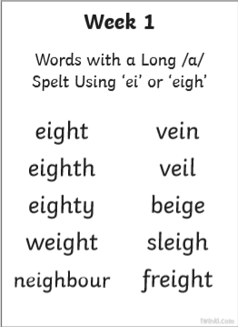
Spelling
New spelling rule every week
Rule will be taught in Monday’s spelling lesson
Follow up lesson on Friday will include activities to assess knowledge of rule

Slide 7
Spelling practise

Slide 8
Maths
Consolidation on what has already been taught in maths
1 revision/ recap question, current learning questions, challenge
All content will have been covered – methods will be shown if necessary
Maths homework will be used to support ongoing progress and monitoring of the children’s understanding

Slide 9
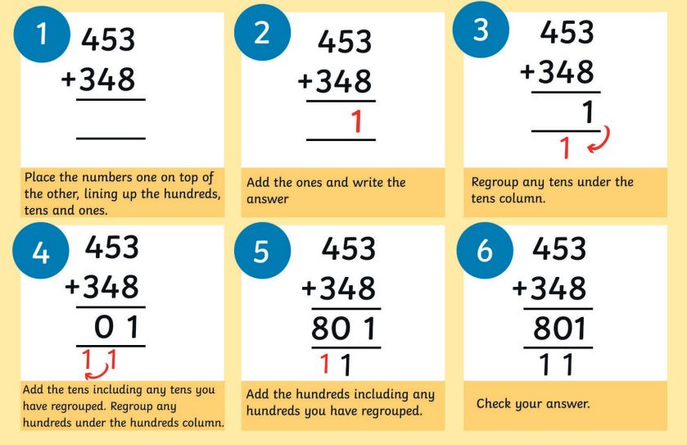
Methods

Slide 10
Catch-up Clubs
By invitation only
Identified areas of further support (confidence, revision, build on foundations)
Change termly – new invitations will go out accordingly
Any questions about individual children, please contact class teacher

Slide 11
Any questions?
Please contact your child’s class teacher if you have any individual

